Slide 1

Lucky 38
Project for lecture 52354-01: Smart Contracts and Decentralized Blockchain Applications
Tim Keller, Viktor Gsteiger

Slide 2
The most exciting blackjack experience
Deployed on Rinkeby testnet
Easy to play
With a website

Slide 3
Basic rules
Don‘t go over 21
Don‘t have less than the dealer
Don‘t loose all money

Slide 4
Implementation
Pay contract
Place bet
Get dealt cards
Either hit or stand
Repeat

Slide 5
Specialities of our implementation
Every player has his own card deck
Many restrictors
Game works fully automatically

Slide 6
Further specialities
Every game gets saved in a mapping
Casino keeps track of all games
Casino gets to keep a little fee for the trouble
Owner can collect this fee

Slide 7
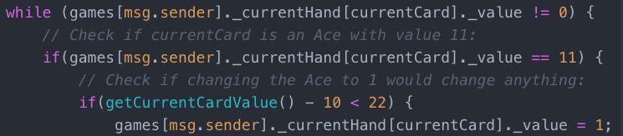
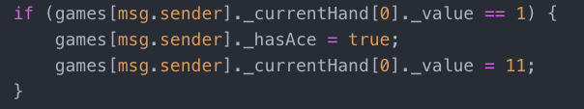
Interesting code bits

Slide 8
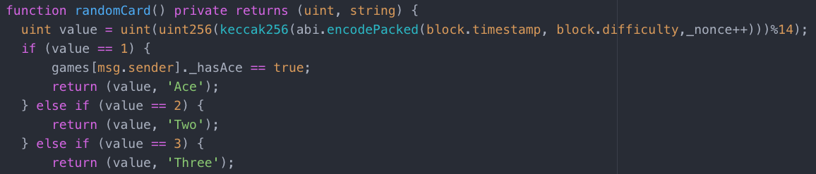
Interesting code bits

Slide 9
Thank you
Check it out now: lucky38.ch

